Slide 1
Software Architecture
software architecture ≅ global design?
architect ≅ designer)
Notes:
© SE, Architecture, Hans van Vliet
Is the notion of software architecture really important?

Slide 2

Overview
What is it , why bother? (Architecture & Design)
Role of the software architect
Viewpoints and view models
Architectural styles
Architecture asssessment
SE, Software Architecture, Hans van Vliet, ©2008
Notes:
© SE, Architecture, Hans van Vliet

Slide 3
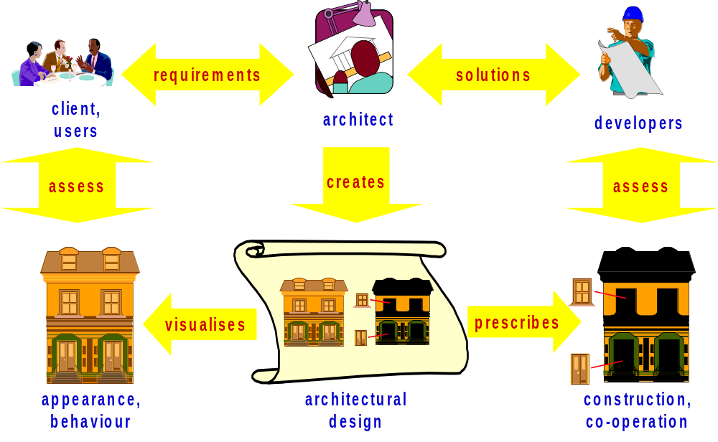
The Role of the Architect
SE, Software Architecture, Hans van Vliet, ©2008
Notes:
© SE, Architecture, Hans van Vliet
In a sense, the two elements on the lower left are new: the elements labeled appearance/behaviour, and the one labelled architectural design

Slide 4
Pre-architecture life cycle
stakeholders
(few)
requirements
quality
agreement
development
SE, Software Architecture, Hans van Vliet, ©2008
Notes:
© SE, Architecture, Hans van Vliet
Iteratie in dit model zit vooral in de requirements, en met slechts een paar stakeholders: onwerpers, opdrachtgever en gebruiker, met name.
Anzelfsprekend is er ook iteratie omdat bv kwaliteitskenmerken niet re realiseren zijn, eea te duur wordt, enz. Maar dat is vaak nadat de overeenkomst gesloten is.

Slide 5
Characteristics
Iteration mainly on functional requirements
Few stakeholders involved (engaged )
No balancing of functional and quality requirements
SE, Software Architecture, Hans van Vliet, ©2008
Notes:
© SE, Architecture, Hans van Vliet

Slide 6
Adding architecture, the easy way
stakeholders
(few)
requirements
quality
agreement
architecture
detailed design
development
implementation
SE, Software Architecture, Hans van Vliet, ©2008
Notes:
© SE, Architecture, Hans van Vliet
Iteratie in dit model zit vooral in de requirements, en met slechts een paar stakeholders: onwerpers, opdrachtgever en gebruiker, met name.
Anzelfsprekend is er ook iteratie omdat bv kwaliteitskenmerken niet re realiseren zijn, eea te duur wordt, enz. Maar dat is vaak nadat de overeenkomst gesloten is.

Slide 7
Architecture in the life cycle
stakeholders
(many)
requirements
quality
architecture
agreement
development
SE, Software Architecture, Hans van Vliet, ©2008
Notes:
© SE, Architecture, Hans van Vliet

Slide 8
Characteristics
Iteration on both functional and quality requirements
Many stakeholders involved
Balancing of functional and quality requirements
SE, Software Architecture, Hans van Vliet, ©2008
Notes:
© SE, Architecture, Hans van Vliet
Hier valt natuurlijk nog veel meer over te zeggen, bv in relatie tot hergebruik, product lines, enz.

Slide 9

Why Is Architecture Important?
Architecture is the vehicle for stakeholder communication
Architecture manifests the earliest set of design decisions
  Constraints on implementation
  Dictates ( control ) organizational structure
  Inhibits (disable ) or enable quality attributes
Architecture is a transferable abstraction of a system
  Product lines share a common architecture
  Allows for template-based development
  Basis for training
SE, Software Architecture, Hans van Vliet, ©2008
Notes:
© SE, Architecture, Hans van Vliet
Vehicle: it is global, often graphical, often uses scenarios.
Early design decisions are important (cost of rework)
Means for planning and control: via the work breakdown structure which is derived from the architecture.
Transferable abstraction: architecture as a linguistic notion, as a basis for reuse, product lines, its use in traing people.

Slide 10

Where did it start?
1992: Perry & Wolf
1987: J.A. Zachman; 1989: M. Shaw
1978/79: David parnas, program families
1972 (1969): Edsger Dijkstra, program families
1969: I.P. Sharp @ NATO Software Engineering conference:
“I think we have something in addition to software engineering , Architecture is different from engineering.”
SE, Software Architecture, Hans van Vliet, ©2008
Notes:
© SE, Architecture, Hans van Vliet
1992: Foundatins for the study of software architecture, Software Engineering Notes
1987: Zachman in IBM Systems Journal: Framework for Information Architecture
1989: Shaw , Larger Scale Systems require Higher Level Abstractions
1972: Dijkstra in Notes on Structured Programming, Note #10. This same text is also present in the proceedings of the 1969 SE conference
Intriguing question: What if the NATO conference was called Software Architecture?

Slide 11
Software architecture, definition (1)
The architecture of a software system defines that system in terms of computational components and interactions among those components.
(from Shaw and Garlan, Software Architecture, Perspectives on an Emerging Discipline, Prentice-Hall, 1996.)
SE, Software Architecture, Hans van Vliet, ©2008
Notes:
© SE, Architecture, Hans van Vliet

Slide 12
Software Architecture
statement
⇓
procedure
⇓
module
⇓
(design) pattern
⇓
architecture
SE, Software Architecture, Hans van Vliet, ©2008
Notes:
© SE, Architecture, Hans van Vliet
This is all about abstraction.
These abstractions first had a specific goal, and later turned into a notion of its own. E.g., procedures at first only served as a shorthand; memory was expensive, and people didn’t want to repeat the same sequence of instructions over and over again. Only later, did the notion of procedural abstraction evolve. Once people have discovered this broader notion, they can use it more effectively.
The same holds for the other abstraction notions, including patterns and architecture.

Slide 13
Software Architecture, definition (2)
The software architecture of a system is the structure or structures of the system, which comprise (contains) software elements, the externally visible properties of those elements, and the relationships among them.
(from Bass, Clements, and Kazman, Software Architecture in Practice, SEI Series in Software Engineering. Addison-Wesley, 2003.)
SE, Software Architecture, Hans van Vliet, ©2008
Notes:
© SE, Architecture, Hans van Vliet
Note: in edition 1, they talked about components, not elements.
Reason for change is that component has a rather (runtime) specific meanng within CBSE: a component is something that can be invoked/activated; but this line is not really followed throughout the book. Ergens verderop staat bv “component is a unit for reuse”

Slide 14
Software Architecture
Important issues raised in this definition:
  multiple system structures;
  externally visible (observable) properties of components.
The definition does not include:
  the process;
  rules and guidelines;
  architectural styles.
SE, Software Architecture, Hans van Vliet, ©2008
Notes:
© SE, Architecture, Hans van Vliet
Externally visible: so you are abstracting from something
architecture defines components; only their interaction counts, not their internals.
Every system has an architecture, and this architecture is not the same as its description (see also next IEEE definition)
Architecture can be good or bad: hence evaluation
Process: how do you get an architecture.
Rules: what should be/not be, in an architecture?

Slide 15
Architecture & Organization 1
Architecture is those attributes visible to the programmer
  Instruction set, number of bits used for data representation, I/O mechanisms, addressing techniques.
Organization is how features are implemented
  Control signals, interfaces, memory technology.
  e.g. Is there a hardware multiply unit or is it done by repeated addition?

Slide 16
Structure & Function
Structure is the way in which components relate to each other
Function is the operation of individual components as part of the structure

Slide 17
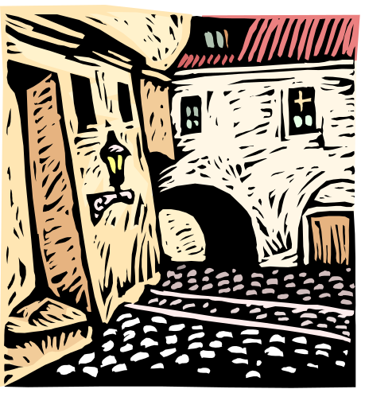
Architectural Structures
module structure
conceptual, or logical structure
process, or coordination structure
physical structure
uses structure
calls structure
data flow
control flow
class structure
SE, Software Architecture, Hans van Vliet, ©2008
Notes:
© SE, Architecture, Hans van Vliet
Module structure: static, aimed at the implementation
Open question: what is the relation between structures?
Later on, in IEEE, and by now generally accepted, these structures are called viewpoints.

Slide 18
Software Architecture, definition (3)
Architecture is the fundamental organization of a system embodied (shaped ) in its components, their relationships to each other and to the environment and the principles guiding its design and evolution
(from IEEE Standard on the Recommended Practice for Architectural Descriptions, 2000.)
SE, Software Architecture, Hans van Vliet, ©2008
Notes:
© SE, Architecture, Hans van Vliet

Slide 19
Software Architecture
Architecture is conceptual.
Architecture is about fundamental of things.
Architecture exists in some context.
SE, Software Architecture, Hans van Vliet, ©2008
Notes:
© SE, Architecture, Hans van Vliet
The architectural descriptions are concrete, but the architecture itself is ingherently conceptual, and cannot be captured in any (set of) views.
Fundamental: so you concentrate on the important things, and abstract from the rest.
An architecture does not exist in the abstract, but always in some context. We can only understand its qualities in its context.

Slide 20
Other points of view
Architecture is high-level design
Architecture is overall structure of the system
Architecture is the structure, including the principles and guidelines governing their design and evolution over time
Architecture is components and connectors
SE, Software Architecture, Hans van Vliet, ©2008

Slide 21
Software Architecture & Quality
The notion of quality is central in software architecting: a software architecture is devised to gain insight in the qualities of a system at the earliest possible stage.
Some qualities are observable via execution: performance, security, availability, functionality, usability
And some are not observable via execution: modifiability, portability, reusability, integrability, testability
SE, Software Architecture, Hans van Vliet, ©2008
Notes:
© SE, Architecture, Hans van Vliet

Slide 22
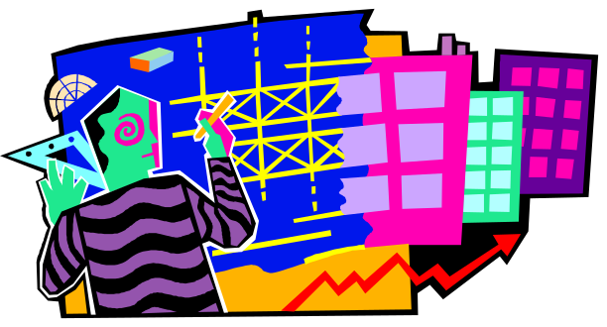
Overview
What is it, why bother?
Architecture Design
Viewpoints and view models
Architectural styles
Architecture asssessment
Role of the software architect
SE, Software Architecture, Hans van Vliet, ©2008
Notes:
© SE, Architecture, Hans van Vliet

Slide 23
Attribute-Driven Design (Bass et al, Ch 7)
Choose module to decompose
Refine this module:
  choose architectural drivers (quality is driving force)
  choose pattern that satisfies drivers
  apply pattern
Repeat steps
SE, Software Architecture, Hans van Vliet, ©2008
Notes:
© SE, Architecture, Hans van Vliet
ADD takes as input a set of quality attribute scenarios (source, stimulus, etc), and employs knowledge about relation between quality and architectural patterns that achieve it.

Slide 24
Example ADD iterations
Top-level: usability ⇒ separate user interface ⇒ Seeheim/three tier architecture
Lower-level, within user interface: security ⇒ authenticate users
Lower-level, within data layer: availability ⇒ active redundancy
SE, Software Architecture, Hans van Vliet, ©2008
Notes:
© SE, Architecture, Hans van Vliet

Slide 25
Generalized model
Understand problem
Solve it
Evaluate solution
SE, Software Architecture, Hans van Vliet, ©2008
Notes:
© SE, Architecture, Hans van Vliet

Slide 26
Global workflow in architecture design
synthesis
architecture
context
backlog
evaluation
requirements
evaluation
results
SE, Software Architecture, Hans van Vliet, ©2008
Notes:
© SE, Architecture, Hans van Vliet

Slide 27
Generalized model (cont’d)
assets
architecture
ideas
synthesis
backlog
evaluation
constraints
eval results
sign.reqs
SE, Software Architecture, Hans van Vliet, ©2008
Notes:
© SE, Architecture, Hans van Vliet

Slide 28
Design issues, options and decisions
A designer is faced with a series of design issues
  These are sub-problems of the overall design problem.
  Each issue normally has several alternative solutions (or design options)
  The designer makes a design decision to resolve each issue.
    This process involves choosing the best option from among the alternatives.
SE, Software Architecture, Hans van Vliet, ©2008
Notes:
© SE, Architecture, Hans van Vliet
Design decisions are the reasons why a certain architecture is the way it is. In this way, a software architecture can be considered as a series of DD.
In taking these DD, the architect is faced with desing issues and options.
...
For example, a design issue can be the type and level of security. Security can be decoposed into authentication (user recognition), authorization (user access to data), privacy (enchryption of data exchanged on a public network).
If the architecture is for a medical system, than both security types are compulsory. If it is for gaming applications, probably not all of them are required, and could be dropped in favor of e.g., higher performance.

Slide 29
Taking decisions
Design
problem
Problem space
sub-
problem
(or issue)
sub-
problem
(or issue)
  Decision =
  best option
Decision space
Design
option
Design
option
Design
option
Design
option
  Decision =
  best option
  Alternative
  solutions
  Alternative
  solutions
SE, Software Architecture, Hans van Vliet, ©2008
Notes:
© SE, Architecture, Hans van Vliet
Organization of the decision process.
- Issues belong to the problem space: expressed as problems to be solved.
- Options belong to the decision space (i.e., possible alternative solutions).
Note: the decision we take is or should be the BEST in this moment, and always with respect to some criterion. If the criterion changes the decision might be not the BEST anymore, and maybe another option is more appropriate.

Slide 30
Decision space
The space of possible designs that can be achieved by choosing different sets of alternatives.
  fat-client
  client in a
  separate
  user interface
  layer
  Programmed in Java
  client-server
  client
  style
  thin-client
  Programmed in Visual Basic
  Programmed in C++
  no separate
  user interface
  layer
  monolithic
SE, Software Architecture, Hans van Vliet, ©2008
Notes:
© SE, Architecture, Hans van Vliet
Very concrete example, maybe too low level.
Issues that can be relevant here in the decision process are: level of flexibility; outsourcing/external acquisition of client technology (that mans need for separate presentation – also relevant for the budget); if using the Web/Internet; performace; ...

Slide 31
Tree or graph?
Issues and options are not independent ...
  fat-client
  client in a
  separate
  user interface
  layer
  flexibility
  client-server
  client
  style
  thin-client
  layered
  MVC
  no separate
  user interface
  layer
  monolithic
SE, Software Architecture, Hans van Vliet, ©2008
Notes:
© SE, Architecture, Hans van Vliet
We need to observe that design issues are not independent.
Example: a number of options become invalid due to a desireable NFR (quality). For example, flexibility could be achieved through certain design patterns, like MVC implementing separation of concerns that can be implemented by corresponding replaceable components, and layered architecture that restricts the client&server interations and hence allows to formalize the role of each component.
If we choose any among the two, we exclude the 'monolithic' subtree and also we need a separate GUI layer.

Slide 32
More than just IT
Technical and non-techical issues and options are intertwined
  Architects deciding on the type of database
  versus
  Management deciding on new strategic partnership
  or
  Management deciding on budget
SE, Software Architecture, Hans van Vliet, ©2008
Notes:
© SE, Architecture, Hans van Vliet
A similar depedency exists between tech and non-tech options.
Here we have an example

Slide 33
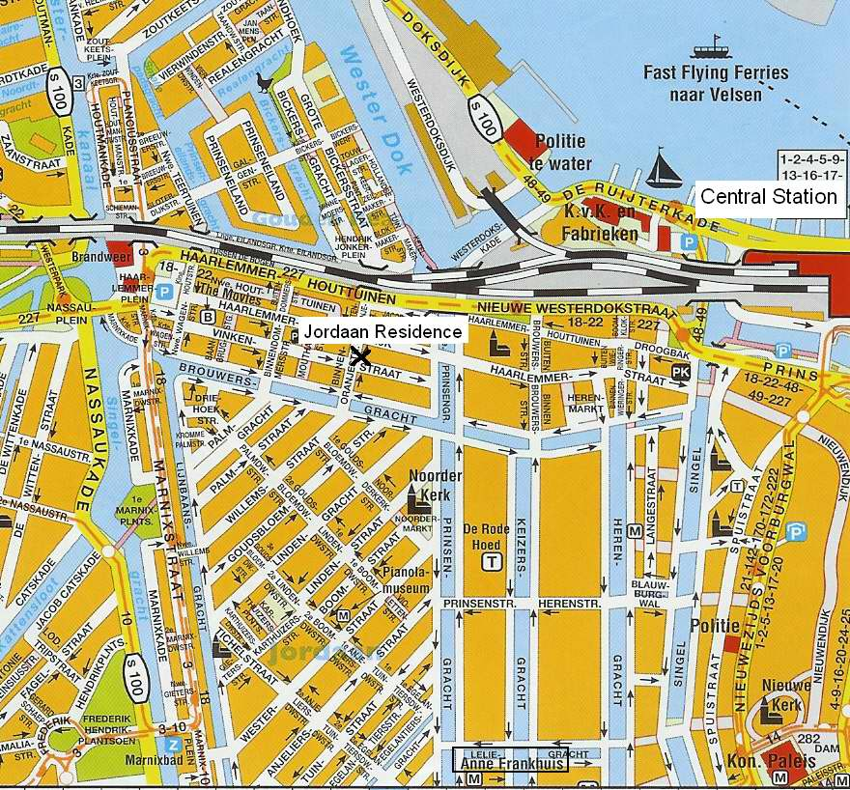
Some (tacit) decisions are related to norms and values
SE, Software Architecture, Hans van Vliet, ©2008
Notes:
© SE, Architecture, Hans van Vliet

Slide 34
Types of decisions
Implicit, undocumented
  Unaware, tacit, of course knowledge
Explicit, undocumented
  Vaporizes over time
Explicit, explicitly undocumented
  Tactical, personal reasons
Explicit, documented
  Preferred, exceptional situation
SE, Software Architecture, Hans van Vliet, ©2008
Notes:
© SE, Architecture, Hans van Vliet

Slide 35
Why is documenting design decisions important?
Prevents repeating (expensive) past steps
Explains why this is a good architecture
Emphasizes qualities and criticality for requirements/goals
Provides context and background
SE, Software Architecture, Hans van Vliet, ©2008
Notes:
© SE, Architecture, Hans van Vliet

Slide 36
Uses of design decisions
Identify key decisions for a stakeholder
  Make the key decisions quickly available. E.g., introducing new people and make them up2date.
  ..., Get a rationale, Validate decisions against reqs
Evaluate impact
  If we want to change an element, what are the elements impacted (decisions, design, issues)?
  ..., Cleanup the architecture, identify important architectural drivers
SE, Software Architecture, Hans van Vliet, ©2008
Notes:
© SE, Architecture, Hans van Vliet
2: use AK, evaluate AK

Slide 37
Elements of a design decision
Issues: design issues being addressed
Decision
Status: e.g., pending, approved
Assumptions: underlying assumptions
Alternatives
Rationale; the why of the decision taken
Implications: e.g. need for further decisions
SE, Software Architecture, Hans van Vliet, ©2008

Slide 38
Pointers on design decisions
Hofmeister et al, Generalizing a Model of Software Architecture Design from Five Industrial Approaches, Journal of Systems and Software, 2007
Tyree and Ackerman, Architecture decisions: demystifying architecture, IEEE Software, vol. 22(2), 2005.
Kruchten, Lago and van Vliet, Building up and exploiting architectural knowledge, WICSA, 2005.
Lago and van Vliet, Explicit assumptions enrich architectural models, ICSE, 2005.
SE, Software Architecture, Hans van Vliet, ©2008
Notes:
© SE, Architecture, Hans van Vliet

Slide 39

Overview
What is it, why bother?
Architecture Design
Viewpoints and view models
Architectural styles
Architecture asssessment
Role of the software architect
SE, Software Architecture, Hans van Vliet, ©2008
Notes:
© SE, Architecture, Hans van Vliet

Slide 40
Software design in UML
Class diagrams, state diagrams, sequence diagram, etc
Who can read those diagrams?
Which type of questions do they answer?
Do they provide enough information?
SE, Software Architecture, Hans van Vliet, ©2008
Notes:
© SE, Architecture, Hans van Vliet

Slide 41
Who can read those diagrams?
Designer, programmer, tester, maintainer, etc.
Client?
User?
SE, Software Architecture, Hans van Vliet, ©2008
Notes:
© SE, Architecture, Hans van Vliet

Slide 42
Which type of questions do they answer?
How much will it cost?
How secure will the system be?
Will it perform?
How about maintenance cost?
What if requirement A is replaced by requirement B?
SE, Software Architecture, Hans van Vliet, ©2008
Notes:
© SE, Architecture, Hans van Vliet

Slide 43
Analogy with building architecture
Overall picture of building (client)
Front view (client, “beauty” committee)
Separate picture for water supply (plumber)
Separate picture for electrical wiring (electrician)
etc
SE, Software Architecture, Hans van Vliet, ©2008
Notes:
© SE, Architecture, Hans van Vliet

Slide 44
Architecture presentations in practice
By and large two flavors:
  Powerpoint slides – for managers, users, consultants, etc
  UML diagrams, for technicians
A small sample …
SE, Software Architecture, Hans van Vliet, ©2008
Notes:
© SE, Architecture, Hans van Vliet

Slide 45
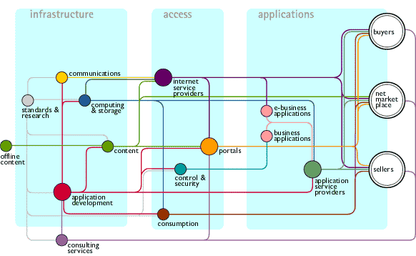
SE, Software Architecture, Hans van Vliet, ©2008
Notes:
© SE, Architecture, Hans van Vliet

Slide 46
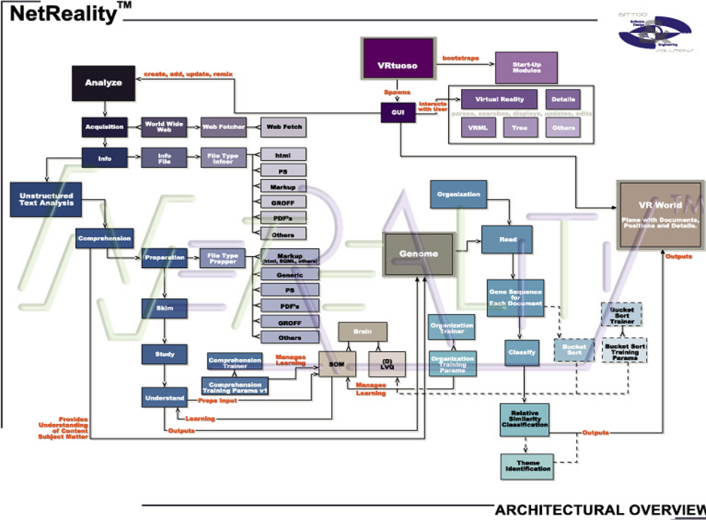
SE, Software Architecture, Hans van Vliet, ©2008
Notes:
© SE, Architecture, Hans van Vliet

Slide 47
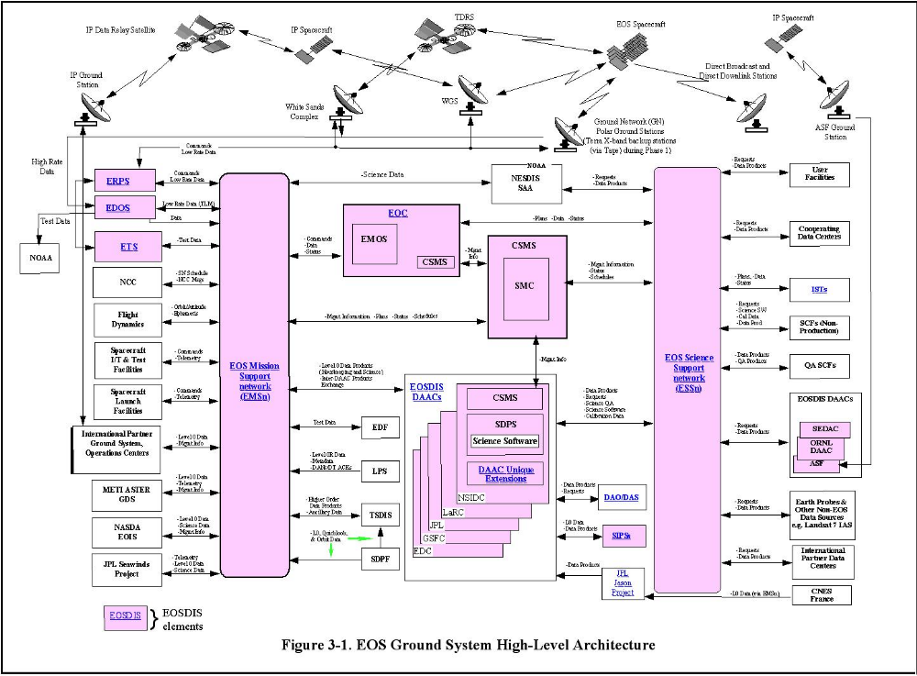
SE, Software Architecture, Hans van Vliet, ©2008
Notes:
© SE, Architecture, Hans van Vliet

Slide 48
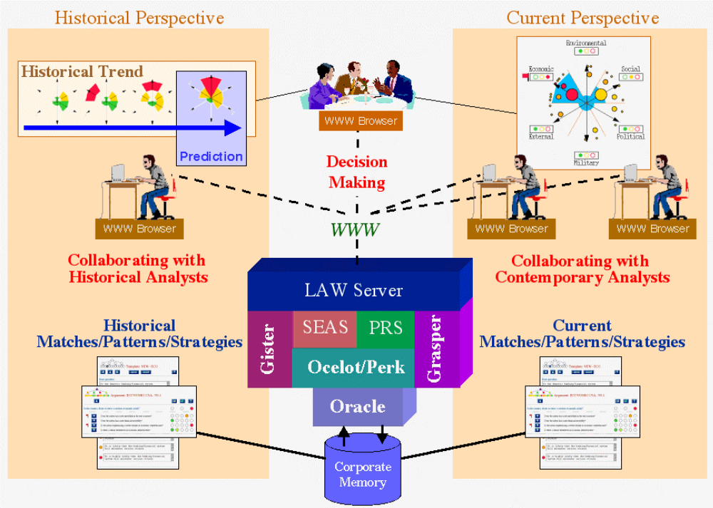
SE, Software Architecture, Hans van Vliet, ©2008
Notes:
© SE, Architecture, Hans van Vliet

Slide 49
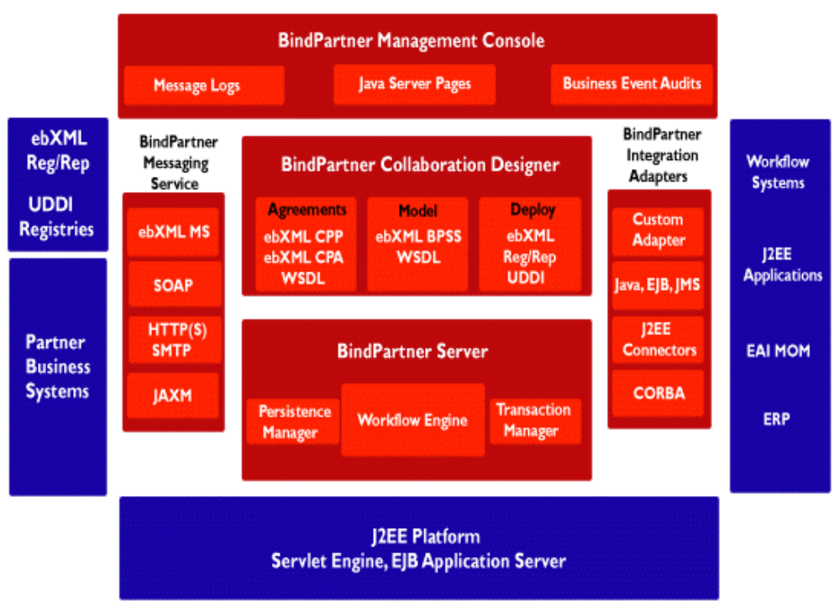
SE, Software Architecture, Hans van Vliet, ©2008
Notes:
© SE, Architecture, Hans van Vliet

Slide 50
So, …
Different representations
For different people
For different purposes
These representations are both descriptive and prescriptive
SE, Software Architecture, Hans van Vliet, ©2008
Notes:
© SE, Architecture, Hans van Vliet
Al die plaatjes hebben wel een soort dubbele functie: ze zijn zowel descriptief (beschrijven iets) als prescriptief (zeggen hoe het moet).
Dat gold trouwens ook voor de plaatjes van de studenten

Slide 51
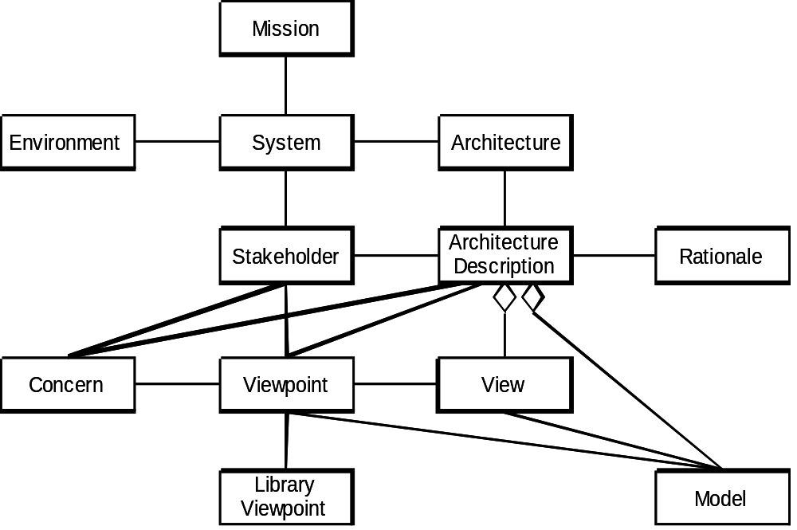
IEEE model for architectural descriptions
SE, Software Architecture, Hans van Vliet, ©2008
Notes:
© SE, Architecture, Hans van Vliet
Dat wiebertje betekent: aggregatie: een view is een deel van een architectuurbeschrijving (part-whole relationship)

Slide 52
Some terms (from IEEE standard)
System stakeholder: an individual, team, or organization (or classes hereof) with interests in, or concerns relative to, a system.
View: a representation of a whole system from the perspective of a related set of concerns.
Viewpoint: A viewpoint establishes the purposes and audience for a view and the techniques or methods employed in constructing a view.
SE, Software Architecture, Hans van Vliet, ©2008
Notes:
© SE, Architecture, Hans van Vliet

Slide 53
Stakeholders
Architect
Requirements engineer
Designer (also of other systems)
Implementor
Tester, integrator
Maintainer
Manager
Quality assurance people
SE, Software Architecture, Hans van Vliet, ©2008
Notes:
© SE, Architecture, Hans van Vliet
Hier gaat het om hun communication needs (p 204).
Architect: negotiates, makes tade-offs
Reqs engineer: idem
Designer: resolve issues, bv rond resource consumption, performance issues
Implementor: constraints and freedoms richting downstream activities.
Tester, integrator: correct black-box behavior of parts.
Maintainer: areas a prospective change will affect.
Manager: maken development team, assign tasks, plan resources, track progress.
QA: basis for conformance checking

Slide 54
Viewpoint specification
Viewpoint name
Stakeholders addressed
Concerns addressed
Language, modeling techniques
SE, Software Architecture, Hans van Vliet, ©2008
Notes:
© SE, Architecture, Hans van Vliet

Slide 55
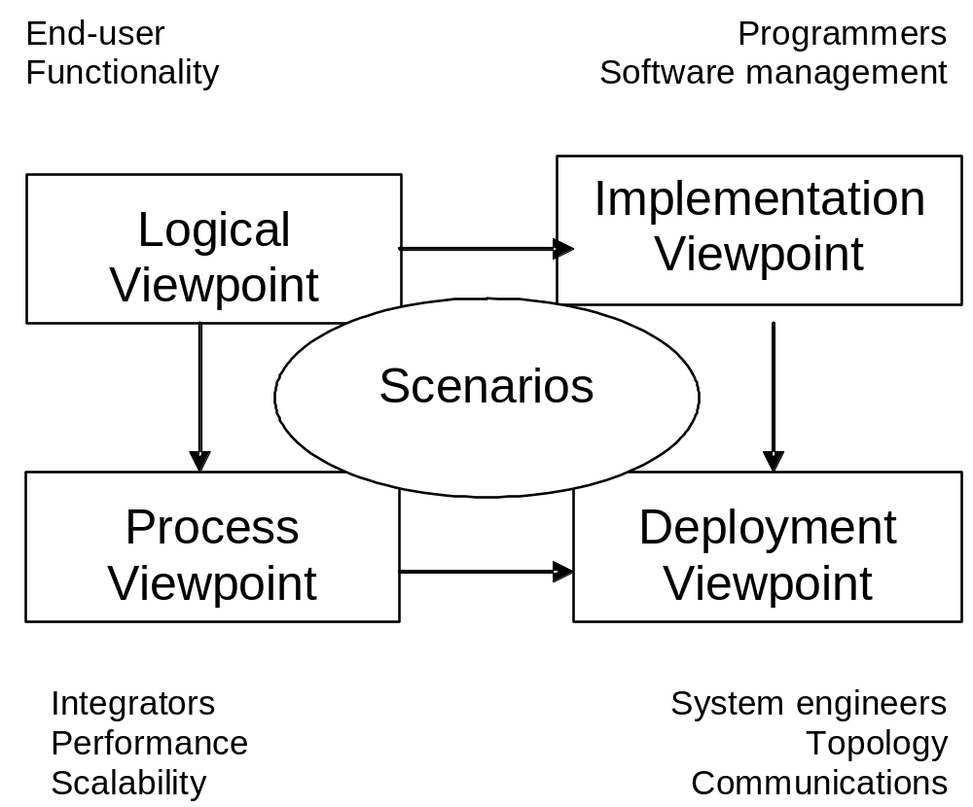
Kruchten’s 4+1 view model
SE, Software Architecture, Hans van Vliet, ©2008
Notes:
© SE, Architecture, Hans van Vliet

Slide 56
4 + 1: Logical Viewpoint
The logical viewpoint supports the functional requirements, i.e., the services the system should provide to its end users.
Typically, it shows the key abstractions (e.g., classes and interactions amongst them).
SE, Software Architecture, Hans van Vliet, ©2008
Notes:
© SE, Architecture, Hans van Vliet
The logical view primarily supports the functional requirements; the services the system should provide to its end users.It depicts the major design elements and their interaction.
Designers decompose the system into a set of key abstractions, taken mainly from the problem domain. These abstractions are objects or object classes that exploit the principles of abstraction, encapsulation, and inheritance. In addition to aiding functional analysis, decomposition identifies mechanisms and design elements that are common across the system.
Components are related by “shares data with”
In termen van het boek is dit een module view

Slide 57
4 + 1: Process Viewpoint
Addresses concurrent aspects at runtime (tasks, threads, processes and their interactions)
It takes into account some nonfunctional requirements, such as performance, system availability, concurrency and distribution, system integrity, and fault-tolerance.
SE, Software Architecture, Hans van Vliet, ©2008
Notes:
© SE, Architecture, Hans van Vliet
The process view takes into account some nonfunctional requirements, such as performance and system availability. It addresses concurrency and distribution, system integrity, and fault-tolerance. The process view also specifies which thread of control executes each operation of each class identified in the logical view.
So the process view describes the mapping of functions to runtime elements. It concenrs the dynamics of the system. A process is a group of tasks which form a logical unit. A process can be started, stopped, resumed, etc., and there is communication between processes.
Components are related by “synchronizes with”
In termen van het boek: een C&C view

Slide 58
4 + 1: Deployment Viewpoint
The deployment viewpoint defines how the various elements identified in the logical, process, and implementation viewpoints-networks, processes, tasks, and objects-must be mapped onto the various nodes.
It takes into account the system's nonfunctional requirements such as system availability, reliability (fault-tolerance), performance (throughput), and scalability.
SE, Software Architecture, Hans van Vliet, ©2008
Notes:
© SE, Architecture, Hans van Vliet
The physical view takes into account the system's nonfunctional requirements such as system availability, reliability (fault-tolerance), performance (throughput), and scalability. The software executes on a network of computers (the processing nodes). The various elements identified in the logical, process, and development views-networks, processes, tasks, and objects-must be mapped onto the various nodes. Several different physical configurations will be used-some for development and testing, others for system deployment at various sites or for different customers. The mapping of the software to the nodes must therefore be highly flexible and have a minimal impact on the source code itself.
Components are related by “communicates with”
In termen van het boek: een allocation view

Slide 59
4 + 1: Implementation Viewpoint
The imlementation viewpoint focuses on the organization of the actual software modules in the software-development environment.
The software is packaged in small chunks-program libraries or subsystems-that can be developed by one or more developers.
SE, Software Architecture, Hans van Vliet, ©2008
Notes:
© SE, Architecture, Hans van Vliet
The development view focuses on the organization of the actual software modules in the software-development environment. The software is packaged in small chunks-program libraries or subsystems-that can be developed by one or more developers. The subsystems are organized in a hierarchy of layers, each layer providing a narrow and well-defined interface to the layers above it.
Components are related by “is submodule of”.
In termen van het boek: een allocation view

Slide 60
4 + 1: Scenario Viewpoint
The scenario viewpoint consists of a small subset of important scenarios (e.g., use cases) to show that the elements of the four viewpoints work together seamlessly.
This viewpoint is redundant with the other ones (hence the "+1"), but it plays two critical roles:
  it acts as a driver to help designers discover architectural elements during the architecture design;
  it validates and illustrates the architecture design, both on paper and as the starting point for the tests of an architectural prototype.
SE, Software Architecture, Hans van Vliet, ©2008
Notes:
© SE, Architecture, Hans van Vliet
The scenario view consists of a small subset of important scenarios-instances of use cases-to show that the elements of the four views work together seamlessly. For each scenario, we describe the corresponding scripts (sequences of interactions between objects and between processes). This view is redundant with the other ones (hence the "+1"), but it plays two critical roles:
it acts as a driver to help designers discover architectural elements during the architecture design;
it validates and illustrates the architecture design, both on paper and as the starting point for the tests of an architectural prototype.
The scenario view is important for stakeholder communication.

Slide 61
Architectural views from Bass et al
(view = representation of a structure)
Module views
  Module is unit of implementation
  Decomposition, uses, layered, class
Component and connector (C & C) views
  These are runtime elements
  Process (communication), concurrency, shared data (repository), client-server
Allocation views
  Relationship between software elements and environment
  Work assignment, deployment, implementation
SE, Software Architecture, Hans van Vliet, ©2008
Notes:
© SE, Architecture, Hans van Vliet
Module structure: static, aimed at the implementation
Open question: what is the relation between structures?
The structure refers to the system itself, the corresponding view is how it is documented.

Slide 62
Module views
Decomposition: units are related by “is a submodule of”, larger modules are composed of smaller ones
Uses: relation is “uses” (calls, passes information to, etc). Important for modifiability
Layered is special case of uses, layer n can only use modules from layers <n
Class: generalization, relation “inherits from”
SE, Software Architecture, Hans van Vliet, ©2008
Notes:
© SE, Architecture, Hans van Vliet
Decomposition: vaak sartpunt voor design, nuttig vor modifiability (likely changes fall within a few modules), basis for project organization, structure of documentation, testplans, etc.
Uses: kun je gebruiken om functional subsets te bepalen. Maakt het dus mogelijk incrementele ontwikkeling te realiseren.
Layered: vaak “taal”, virtual machine.
Class: dan kun je redeneren over reuse, incremental addition of functionality.

Slide 63
Component and connector views
Process: units are processes, connected by communication or synchronization
Concurrency: to determine opportunities for parallelism (connector = logical thread)
Shared data: shows how data is produced and consumed
Client-server: cooperating clients and servers
SE, Software Architecture, Hans van Vliet, ©2008
Notes:
© SE, Architecture, Hans van Vliet
Process: relation is “attachment”, how are cmponents hooked together. Belangrijk voor performance, availability.
Concurrency: logical thread: sequence of computation that can be allocated to a separate physical thread later in the design rpocess. Used to determine possibilities for concurrency.
Shared data: gaatibution, load balancing (runtime performamce) over componenten die persistent data maken, opslaan, gebruiken. Handig als systeem dat voral doet. Goed voor performace, data integrity.
Client-server: connectors are the protocols and messages they exchange. Goed voor separation of concerns (modifiabilty), physical distribution

Slide 64
Allocation views
Deployment: how software is assigned to hardware elements
Implementation: how software is mapped onto file structures
Work assignment: who is doing what
SE, Software Architecture, Hans van Vliet, ©2008
Notes:
© SE, Architecture, Hans van Vliet
Deployment: elements: software (meestal process van C&C view), hardware elements and communication pathways. Geeft aan waar software zit, en hoe het evt migreert. Dan kun je redeneren over performance, security, availability, ed.
Implementation: voor management van ontwikkelactiviteiten, build processes.
Work assignment: welke kennis heb je waar nodig?, functional commonality aan 1 team toewijzen, etc.

Slide 65
How to decide on which viewpoints
What are the stakeholders and their concerns?
Which viewpoints address these concerns?
Prioritize and possibly combine viewpoints
SE, Software Architecture, Hans van Vliet, ©2008
Notes:
© SE, Architecture, Hans van Vliet
Bv via het maken van een stakeholder/view list. Geef aan hoeveel uit elke vew de stakeholders nodig hebben.
Vaak zul je views willen combineren, want je wilt er geen 12 maken. (bv module decomposition and implementation view kun je vaak combineren. Of module decomposition en layered of uses).

Slide 66
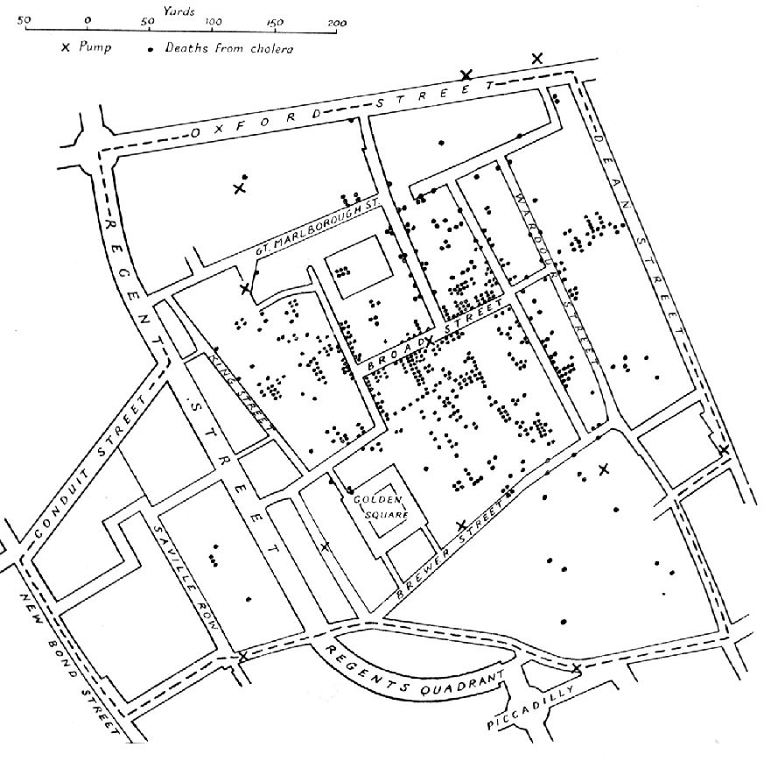
Decision visualization
SE, Software Architecture, Hans van Vliet, ©2008
Notes:
© SE, Architecture, Hans van Vliet
Londense arts, Snow. Platje komt uit Wikipedia

Slide 67
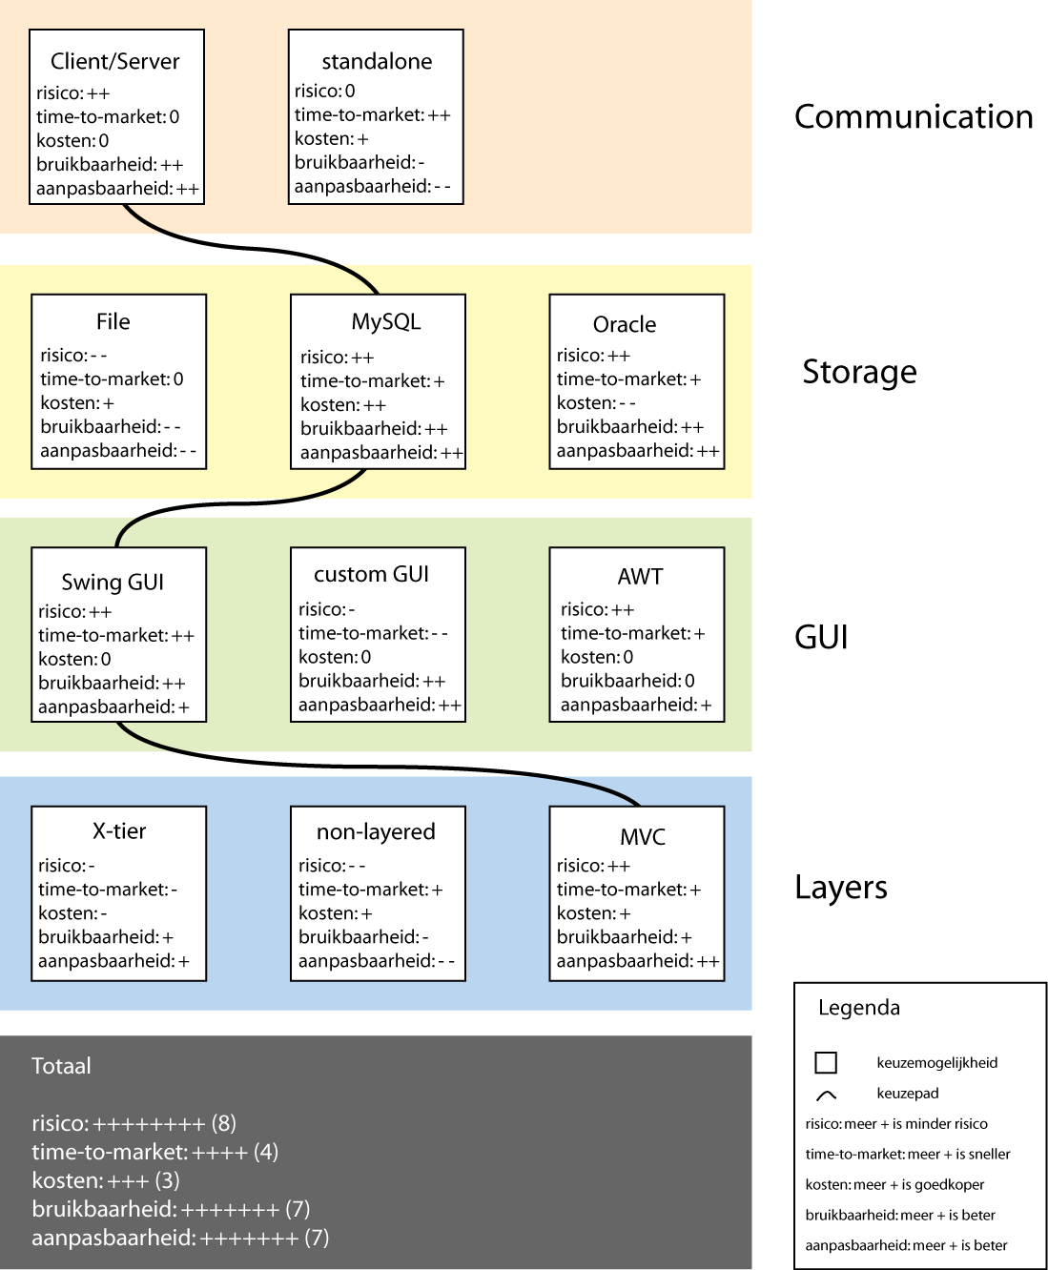
Business viewpoint
SE, Software Architecture, Hans van Vliet, ©2008
Notes:
© SE, Architecture, Hans van Vliet

Slide 68
A caveat on quality
A view can be used to assess one or more quality attributes
E.g., some type of module view can be used to assess modifiability
It should then expose the design decisions that affect this quality attribute
SE, Software Architecture, Hans van Vliet, ©2008
Notes:
© SE, Architecture, Hans van Vliet
No single description (view) captures an architecture completely
Note that these views concern the system itself (the micro-architecture), and not the system in its environment (the macro architecture).
The 4+1 views are from the 1995 IEEE Software article. A similar set of views is given in Soni et al, 1995, ICSE proceedings.

Slide 69

Overview
What is it, why bother?
Architecture Design
Viewpoints and view models
Architectural styles
Architecture asssessment
Role of the software architect
SE, Software Architecture, Hans van Vliet, ©2008
Notes:
© SE, Architecture, Hans van Vliet

Slide 70
Architectural styles
An architectural style is a description of component and connector types and a pattern of their runtime control and/or data transfer.
Examples:
  main program with subroutines
  data abstraction
  implicit invocation
  pipes and filters
  repository (blackboard)
  layers of abstraction
SE, Software Architecture, Hans van Vliet, ©2008
Notes:
© SE, Architecture, Hans van Vliet

Slide 71
Alexander’s patterns
There is abundance evidence to show that high buildings make people crazy.
High buildings have no genuine advantage, except in speculative gains. They are not cheaper, they do not help to create open space, they make life difficult for children, they wreck the open spaces near them. But quite apart from this, empirical evidence shows that they can actually damage people’s minds and feelings.
In any urban area, keep the majority of buildings four stories high or less. It is possible that certain buildings should exceed this limit, but they should never be buildings for human habitation.
SE, Software Architecture, Hans van Vliet, ©2008
Notes:
© SE, Architecture, Hans van Vliet

Slide 72
General flavor of a pattern
IF you find yourself in <context>, for example <examples>, with <problem>
THEN for some <reasons>, apply <pattern> to construct a solution leading to a <new context> and <other patterns>
SE, Software Architecture, Hans van Vliet, ©2008
Notes:
© SE, Architecture, Hans van Vliet

Slide 73
Components and Connectors
Components are connected by connectors.
They are the building blocks with which an architecture can be described.
No standard notation has emerged yet.
SE, Software Architecture, Hans van Vliet, ©2008
Notes:
© SE, Architecture, Hans van Vliet

Slide 74
Types of components
computational: does a computation of some sort. E.g. function, filter.
memory: maintains a collection of persistent data. E.g. data base, file system, symbol table.
manager: contains state + operations. State is retained between invocations of operations. E.g. adt, server.
controller: governs time sequence of events. E.g. control module, scheduler.
SE, Software Architecture, Hans van Vliet, ©2008
Notes:
© SE, Architecture, Hans van Vliet

Slide 75
Types of connectors
procedure call (including RPC)
data flow (e.g. pipes)
implicit invocation
message passing
shared data (e.g. blackboard or shared data base)
instantiation
SE, Software Architecture, Hans van Vliet, ©2008
Notes:
© SE, Architecture, Hans van Vliet

Slide 76
Framework for describing architectural styles
problem: type of problem that the style addresses. Characteristics of the reqs’s guide the designer in his choice for a particular style.
context: characteristics of the environment that constrain the designer, req’s imposed by the style.
solution: in terms of components and connectors (choice not independent), and control structure (order of execution of components)
variants
examples
SE, Software Architecture, Hans van Vliet, ©2008

Slide 77
Main-program-with-subroutines style
problem: hierarchy of functions; result of functional decomposition, single thread of control
context: language with nested procedures
solution:
  system model: modules in a hierarchy, may be weak or strong, coupling/cohesion arguments
  components: modules with local data, as well as global data
  connectors: procedure call
  control structure: single thread, centralized control: main program pulls the strings
variants: OO versus non-OO
SE, Software Architecture, Hans van Vliet, ©2008
Notes:
© SE, Architecture, Hans van Vliet

Slide 78
Abstract-data-type style
problem: identify and protect related bodies of information. Data representations likely to change.
context: OO-methods which guide the design, OO-languages which provide the class-concept
solution:
  system model: component has its own local data (= secret it hides)
  components: managers (servers, objects, adt’s)
  connectors: procedure call (message)
  control structure: single thread, usually; control is decentralized
variants: caused by language facilities
SE, Software Architecture, Hans van Vliet, ©2008
Notes:
© SE, Architecture, Hans van Vliet

Slide 79
Implicit-invocation style
problem: loosely coupled collection of components. Useful for applications which must be reconfigurable.
context: requires event handler, through OS or language.
solution:
  system model: independent, reactive processes, invoked when an event is raised
  components: processes that signal events and react to events
  connectors: automatic invocation
  control structure: decentralized control. Components do not know who is going to react.
variants: Tool-integration frameworks, and languages with special features.
SE, Software Architecture, Hans van Vliet, ©2008
Notes:
© SE, Architecture, Hans van Vliet

Slide 80
Pipes-and-filters style
problem: independent, sequential transformations on ordered data. Usually incremental, Ascii pipes.
context: series of incremental transformations. OS-functions transfer data between processes. Error-handling difficult.
solution:
  system model: continuous data flow; components incrementally transform data
  components: filters for local processing
  connectors: data streams (usually plain ASCII)
  control structure: data flow between components; component has own flow
variants: From pure filters with little internal state to batch processes
SE, Software Architecture, Hans van Vliet, ©2008
Notes:
© SE, Architecture, Hans van Vliet

Slide 81
Repository style
Client
Client
Shared Data
Client
problem: manage richly structured information, to be manipulated in many different ways. Data is long-lived.
context: shared data to be acted upon by multiple clients
solution:
  system model: centralized body of information. Independent computational elements.
  components: one memory, many computational
  connectors: direct access or procedure call
  control structure: varies, may depend on input or state of computation
variants: traditional data base systems, compilers, blackboard systems
SE, Software Architecture, Hans van Vliet, ©2008
Notes:
© SE, Architecture, Hans van Vliet

Slide 82
Layered style
Layer_{n}
Layer₂
Layer₁
problem: distinct, hierarchical classes of services. “Concentric circles” of functionality
context: a large system that requires decomposition (e.g., virtual machines, OSI model)
solution:
  system model: hierarchy of layers, often limited visibility
  components: collections of procedures (module)
  connectors: (limited) procedure calls
  control structure: single or multiple threads
variants: relaxed layering
SE, Software Architecture, Hans van Vliet, ©2008
Notes:
© SE, Architecture, Hans van Vliet

Slide 83
Model-View-Controller (MVC) style
Controller
View
n
n
Model
problem: separation of UI from application is desirable due to expected UI adaptations
context: interactive applications with a flexible UI
solution:
  system model: UI (View and Controller Component(s)) is decoupled from the application (Model component)
  components: collections of procedures (module)
  connectors: procedure calls
  control structure: single thread
variants: Document-View
SE, Software Architecture, Hans van Vliet, ©2008
Notes:
© SE, Architecture, Hans van Vliet

Slide 84

Overview
What is it, why bother?
Architecture Design
Viewpoints and view models
Architectural styles
Architecture asssessment
Role of the software architect
SE, Software Architecture, Hans van Vliet, ©2008
Notes:
© SE, Architecture, Hans van Vliet

Slide 85
Architecture evaluation/analysis
Assess whether architecture meets certain quality goals, such as those w.r.t. maintainability, modifiability, reliability, performance
Mind: the architecture is assessed, while we hope the results will hold for a system yet to be built
SE, Software Architecture, Hans van Vliet, ©2008
Notes:
© SE, Architecture, Hans van Vliet

Slide 86
Software Architecture Analysis
Software
architecture
implementation
System
properties
Qualities
Properties
SE, Software Architecture, Hans van Vliet, ©2008
Notes:
© SE, Architecture, Hans van Vliet
Je “test” dus die properties, en je hoopt dat, als het systeem eenmaal geimlementeerd is, dat systeem de betreffende kwaliteitseigenschappen zal hebben.

Slide 87
Analysis techniques
Questioning techniques: how does the system react to various situations; often make use of scenarios
Measuring techniques: rely on quantitative measures; architecture metrics, simulation, etc
SE, Software Architecture, Hans van Vliet, ©2008
Notes:
© SE, Architecture, Hans van Vliet
Metrics kun je je voorstellen als bij “gewone” programma’s: tellen van aantallen nterfaces, aantallen functies, vorm van een gelayerde architectuur, ed. Heeft dan allemaal met coupling en cohesion te maken.
Simulatie is behoorljk ingewikkeld. Je maakt dan iha gebruik van tools, doet bepaalde aannamen over onderdelen van de architectuur (gemiddelde dorlooptijd van compnenten ed, snelheid netwerk, etc), en doet op basis daarvan uitspraken.
Scenarios worden waarschijnlijk het meest gebruikt. Zijn ook een manier om stakehlders erbij te betrekken. Een beetje zoals facilitated workshops bij requirements analyse dat doen.

Slide 88
Scenarios in Architecture Analysis
Different types of scenarios, e.g. use-cases, likely changes, stress situations, risks, far-into-the-future scenarios
Which stakeholders to ask for scenarios?
When do you have enough scenarios?
SE, Software Architecture, Hans van Vliet, ©2008
Notes:
© SE, Architecture, Hans van Vliet
A change scenario is a description of a concrete event that might lead to a change in the system. E.g. a move from Windows 2000 to Windows NT.
Often, the architect will be asked for likely changes. Chances are he will come up with changes already anticipated by the architecture. This is somewhat akin to testing your own software.
Is 10 scenarios enough? Or 1000? There are no good stopping criteria, yet.

Slide 89
Preconditions for successful assessment
Clear goals and requirements for the architecture
Controlled scope
Cost-effectiveness
Key personnel availability
Competent evaluation team
Managed expectations
SE, Software Architecture, Hans van Vliet, ©2008
Notes:
© SE, Architecture, Hans van Vliet
Een architectuur heeft alleen betekenis in de context van een set kwaliteitseisen. Als je die niet hebt is elke architectuur goed.
Je kunt, met de hand en n een groep, niet teveel tegelijk doen. Dus scope beperken. Bv alleen modifiability, of modifiability + performance.
Kosten moeten < opbrengsten zijn
Key personnell: architect oid : stakeholders die bij major concerns horen
Liefst een apart team: onafhankelijk, objectief, goed. Anders wordt het niet opgevolgd. Misschien moeten ze wel een zekere macht hebben.
Verwachtingen van assessment: welke, wat levert het op, wat gebeurt daarmee, wie krijgt de resultaten.

Slide 90
Architecture Tradeoff Analysis Method (ATAM)
Reveals how well architecture satisfies quality goals, how well quality attributes interact, i.e. how they trade off
Elicits business goals for system and its architecture
Uses those goals and stakeholder participation to focus attention to key portions of the architecture
SE, Software Architecture, Hans van Vliet, ©2008
Notes:
© SE, Architecture, Hans van Vliet
Het is een soort inspectie, waarbij je met een groep stakeholders in een dialoog komt over de architectuur.
Het enge, nauwe, doel is om quality te testen. Maar vaak is wat eruit kmt breder, en gaat het m meer zaken. Wat dat betreft is het net als andere techneken om samen met betrokkenen gestructureerd over een systeem te praten.
Active design reviews van Parnas hebben aan de basis van ATAM ed gestan.

Slide 91
Benefits
Financial gains
Forced preparation
Captured rationale
Early detection of problems
Validation of requirements
Improved architecture
SE, Software Architecture, Hans van Vliet, ©2008
Notes:
© SE, Architecture, Hans van Vliet
Ervaringen bij AT&T: 10% reductie in kosten. Er zijn veel anecdotes, weinig harde getallen.
Forced preparation: je moet documentatie maken, dus nadenken over je beslissingen.
Zo krijg je rationale, en die is tijdens evolutie van zeer groot belang.
Early detetction: als alle vroege testtechnieken
Veel requirements worden zmaar “gesteld”, en niemand weet of ze haalbaar zijn. Requirements kunnen ook conflicten opleveren. Bij architectuurevaluatie kom je die hopelijk tegen, en dan kn je er over onderhandelen, en afspraken maken waarbij je dan weet wat je afgesproken hebt.
En tenslotte, de architectuur kan er aleen maar beter van worden. En dat geldt niet alleen voor de architectuur in kwestie, maar ook voor volgende architecturen. Net als bij testen, je wordt een betere ontwikkelaar als je nspecties doet. Het is een leerproces voor betrokkenen.

Slide 92
Participants in ATAM
Evaluation team
Decision makers
Architecture stakeholders
SE, Software Architecture, Hans van Vliet, ©2008
Notes:
© SE, Architecture, Hans van Vliet
Evaluation team: van buiten het project

Slide 93
Phases in ATAM
0: partnership, preparation (informally)
1: evaluation (evaluation team + decision makers, one day)
2: evaluation (evaluation team + decision makers + stakeholders, two days)
3: follow up (evaluation team + client)
SE, Software Architecture, Hans van Vliet, ©2008

Slide 94
Steps in ATAM (phase 1 and 2)
Present method
Present business drivers (by project manager of system)
Present architecture (by lead architect)
Identify architectural approaches/styles
Generate quality attribute utility tree (+ priority, and how difficult)
Analyze architectural approaches
Brainstorm and prioritize scenarios
Analyze architectural approaches
Present results
SE, Software Architecture, Hans van Vliet, ©2008
Notes:
© SE, Architecture, Hans van Vliet
Utility tree: tree whose root is “utility”, and whose leafs are scenarios (see next slide). This utility tree guides the rest of the analysis.
During the analysis, the architecture is analyzed to see whether the the selected styles “hold promise for meeting the attribute specific requirements for which it is intended”. The key is to link architectural decisions and quality attribute requirements that need to be satisfied.

Slide 95
Example Utility tree
Transaction response time (H, M)
Performance
Throughput
150 transactions/sec
Training
Utility
Usability
Normal operations
Maintainability
Database vendor releases
new version
SE, Software Architecture, Hans van Vliet, ©2008
Notes:
© SE, Architecture, Hans van Vliet

Slide 96
Outputs of ATAM
Concise presentation of the architecture
Articulation of business goals
Quality requirements expressed as set of scenarios
Mapping of architectural decisions to quality requirements
Set of sensitivity points and tradeoff points
Set of risks, nonrisks, risk themes
SE, Software Architecture, Hans van Vliet, ©2008
Notes:
© SE, Architecture, Hans van Vliet
Sensitivity point: property of component that is critical to achieve a particular quality attribute response. Bv gemiddeld aantal dagen voor onderhoud kan gevoelig zijn voor de mate van encapsulatie van file formats. Of latency (slapend; wrsch wachttijd) voor processing message kan afhankelijk zijn van prioriteit van processen die deze message verwerken.
Tradeoff point: property die op meer dan een attribuut slaat en sensitivity point voor meer dan 1 attribuut is. Als je bv het nivo van encryptie verandert heeft dat een significante invloed op zowel security als performance (maar wel in verschillende richtingen). Dus je wilt speciaal op tradeoff points letten.

Slide 97
Important concepts in ATAM
Sensitivity point: decision/property critical for certain quality attribute
Tradeoff point: decision/property that affects more than one quality attribute
Risk: decision/property that is a potential problem
These concepts are overlapping
SE, Software Architecture, Hans van Vliet, ©2008
Notes:
© SE, Architecture, Hans van Vliet
Example sensitivity points: level of confidentiality is sensitive to number of bits of encryption. Average number of persondays needed for maintenance might be sensitive to degree of encapsulation
Tadeoff: changing level of encryption -> more security, less performance.

Slide 98
Software Architecture Analysis Method (SAAM)
Develop scenarios for
  kinds of activities the system must support
  kinds of changes anticipated
Describe architecture(s)
Classify scenarios
  direct -- use requires no change
  indirect -- use requires change
Evaluate indirect scenarios: changes and cost
Reveal scenario interaction
Overall evaluation
SE, Software Architecture, Hans van Vliet, ©2008
Notes:
© SE, Architecture, Hans van Vliet
SAAM is eenvoudiger dan ATAM.
If two scenarios affect the same component, these scenarios are said to interact. If there is an interaction between scenarios that are semantically not related, the decomposition is, potentially, not so good.

Slide 99
Scenario interaction in SAAM
Two (indirect) scenarios interact if they require changes to the same component
Scenario interaction is important for two reasons:
  Exposes allocation of functionality to the design
  Architecture might not be at right level of detail
SE, Software Architecture, Hans van Vliet, ©2008
Notes:
© SE, Architecture, Hans van Vliet
Allocation of functionality: if semantically unrelated scenarios interact, decomposition is not proper. Semantically unrelated things are in the same component.
On the oher hand, we may have to decompose the architecture further, to get smaller subcomponents that do not interact.

Slide 100

Overview
What is it, why bother?
Architecture Design
Viewpoints and view models
Architectural styles
Architecture asssessment
Role of the software architect
SE, Software Architecture, Hans van Vliet, ©2008
Notes:
© SE, Architecture, Hans van Vliet

Slide 101
Role of the software architect
Key technical consultant
Make decisions
Coach of development team
Coordinate design
Implement key parts
Advocate software architecture
SE, Software Architecture, Hans van Vliet, ©2008
Notes:
© SE, Architecture, Hans van Vliet
In my view, making decisions, in concultation with ALL stakeholders, is the most crucial issue for the software architect.

Slide 102
Summary
new and immature field
proliferation of terms: architecture - design pattern - framework - idiom
architectural styles and design pattern describe (how are things done) as well as prescribe (how should things be done)
stakeholder communication
early evaluation of a design
transferable abstraction
SE, Software Architecture, Hans van Vliet, ©2008
Notes:
© SE, Architecture, Hans van Vliet

Slide 103
Further reading
Mary Shaw and David Garlan, Software Architecture; Perspectives of an Emerging Discipline, 1995.
Philippe B. Kruchten, The 4+1 view model of architecture, IEEE Software, 12(6):42-50, November 1995.
Frank Buschmann et al., Pattern-Oriented Software Architecture: A System of Patterns, 1996. Part II: 2001.
Erich Gamma et al., Design Patterns: Elements of Reusable Object-Oriented Software, 1995.
Len Bass et al, Sofware Architecture in Practice, 2003 (2nd edition).
C. Hofmeister et al., Applied Software Architecture, 1999.
Jan Bosch, Design & Use of Software Architectures, 2000.
SE, Software Architecture, Hans van Vliet, ©2008

